Slide 1


Tmall 11.11
Repeat Buyers Prediction
by Frank, Joe, Diana

Slide 2
1
Background & Goal
2
Data Description
CONTENTS
3
Exploratory Analysis
4
Feature Engineering
5
Next Steps

Slide 3
1
Background & Goal

Slide 4
Background
Tmall runs big promotions on “Double 11” - the biggest online shopping event in China, in order to attract a large number of new buyers
Unfortunately, many of the attracted buyers are one-time deal hunters, and these promotions may have little long lasting impact on sales
To reduce the promotion cost and enhance the return on investment (ROI), Tmall wants to identify who can be converted into repeated buyers

Slide 5
Goal
Predict the probability of the given user becoming a repeat buyer of the given merchant in the future
Identify characteristics contributing the most to predict repeat buyers

Slide 6
2
Data Description

Slide 7
Data Description
The data set is provided by Alibaba Cloud
The data set contains anonymized user’s shopping logs in the past 6 months before and on the “Double 11” day
Due to privacy issue, data is sampled in a biased way, so the statistical result on this data set would deviate from the actual of Tmall.com. But it will not influence the applicability of the solution.

Slide 8
Data Source
User Profile
age_range
gender
user_id

Slide 9
Research Questions
User Behavior logs
user_id
merchant_id
a unique id for the shopper
a unique id for the merchant
User Behavior Logs
item_id
brand_id
a unique id for the item
a unique id for the brand of the item
cat_id
time_stamp
a unique id for the category that the item belongs to
Date the action took place
action_type
click, add-to-cart, purchase, and add-to favorite
Notes:
action_type: set of interaction records between {user_id, merchant_id}, where each record is an action

Slide 10
3
Exploratory Analysis

Slide 11
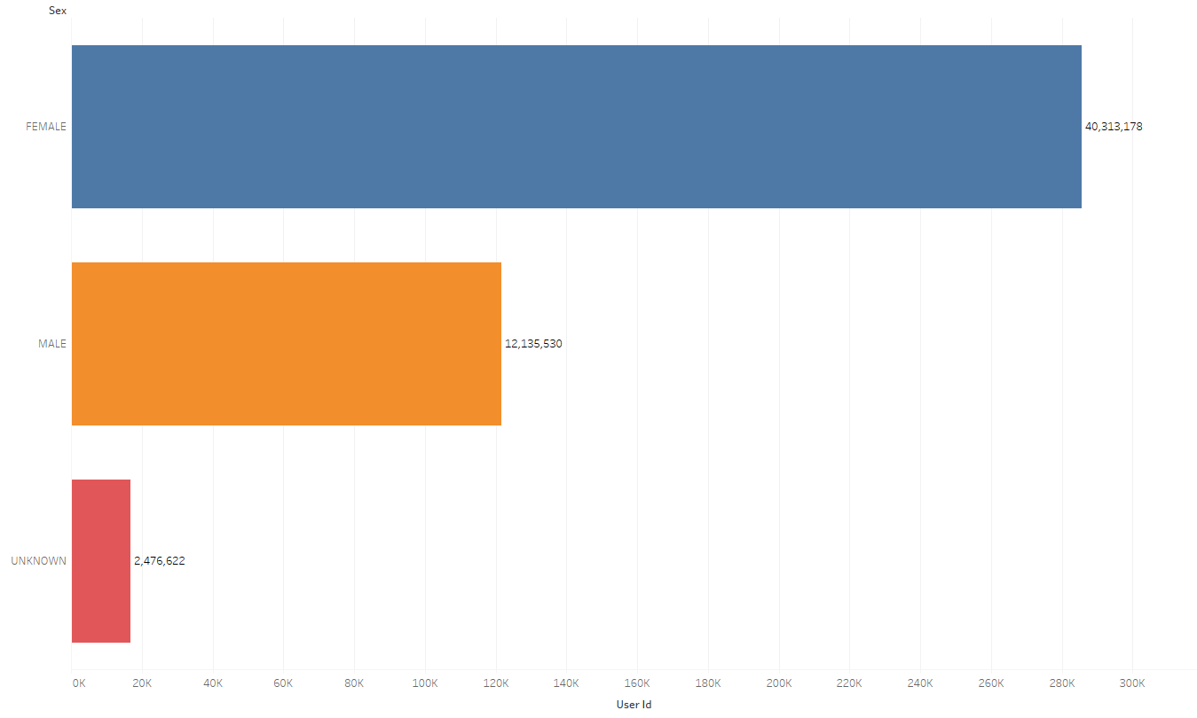
Data Source
User Gender
Most of the users are female

Slide 12
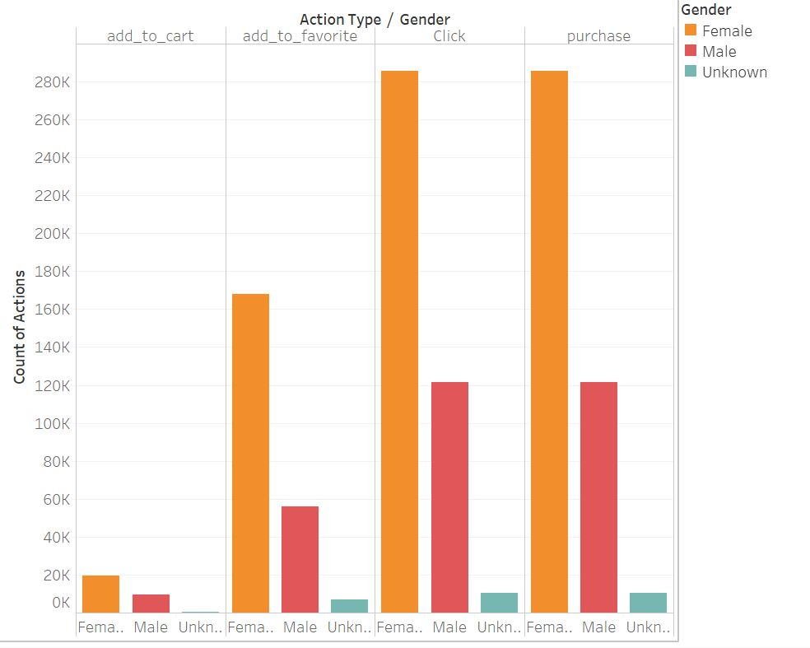
Data Source
User Gender
Female users dominate viewing and purchasing actions in our data

Slide 13
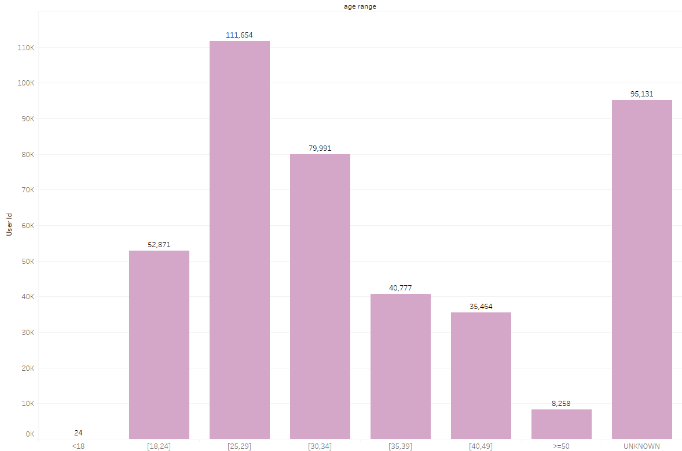
Data Source
User Age
Most of the users are between 25 and 29

Slide 14
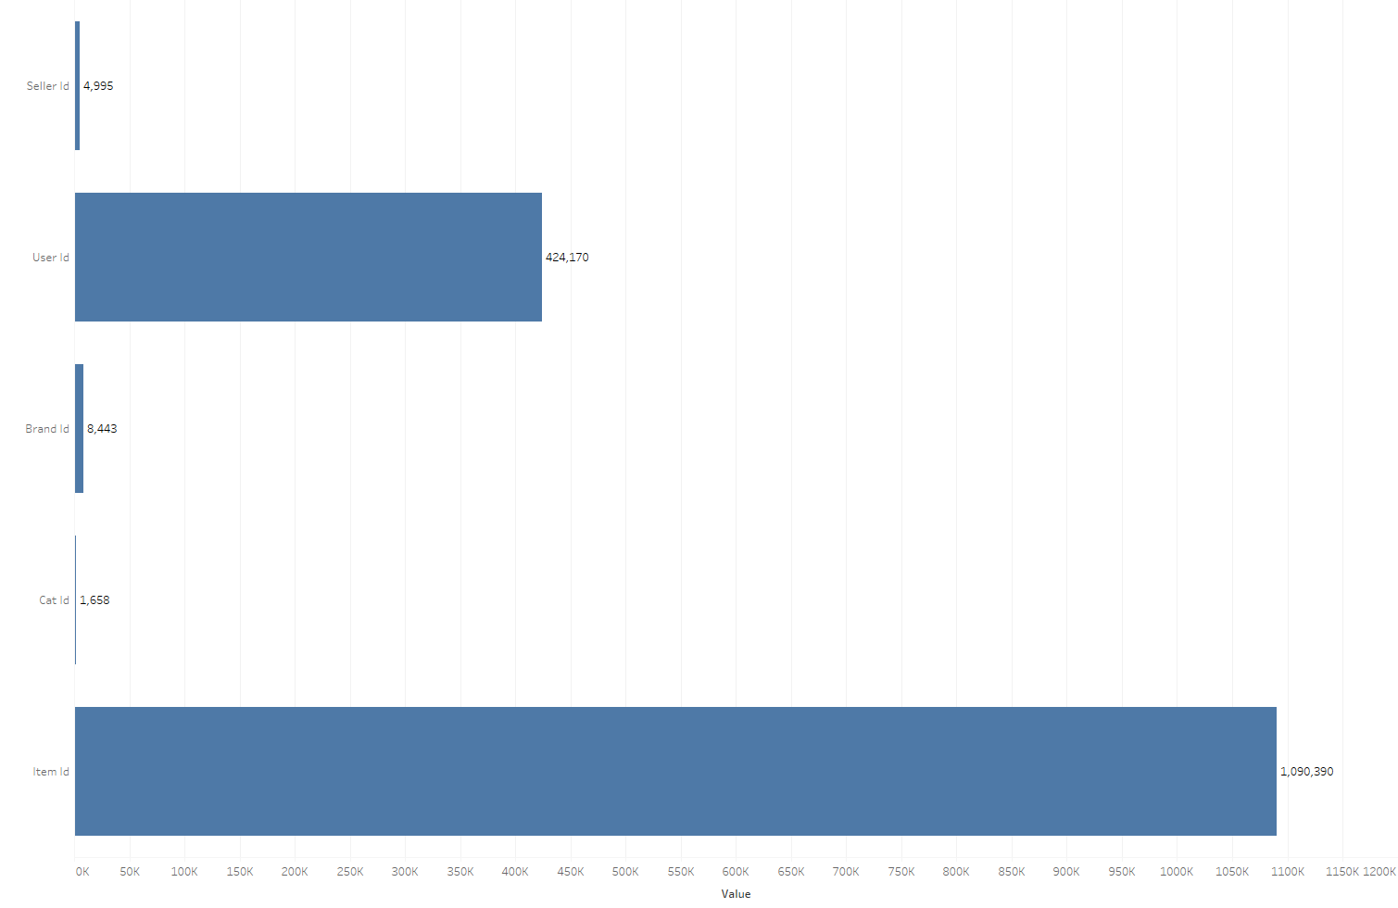
Data Source
Distinct # of ID
# of users is almost 100 times that of sellers
Millions of distinct items!

Slide 15
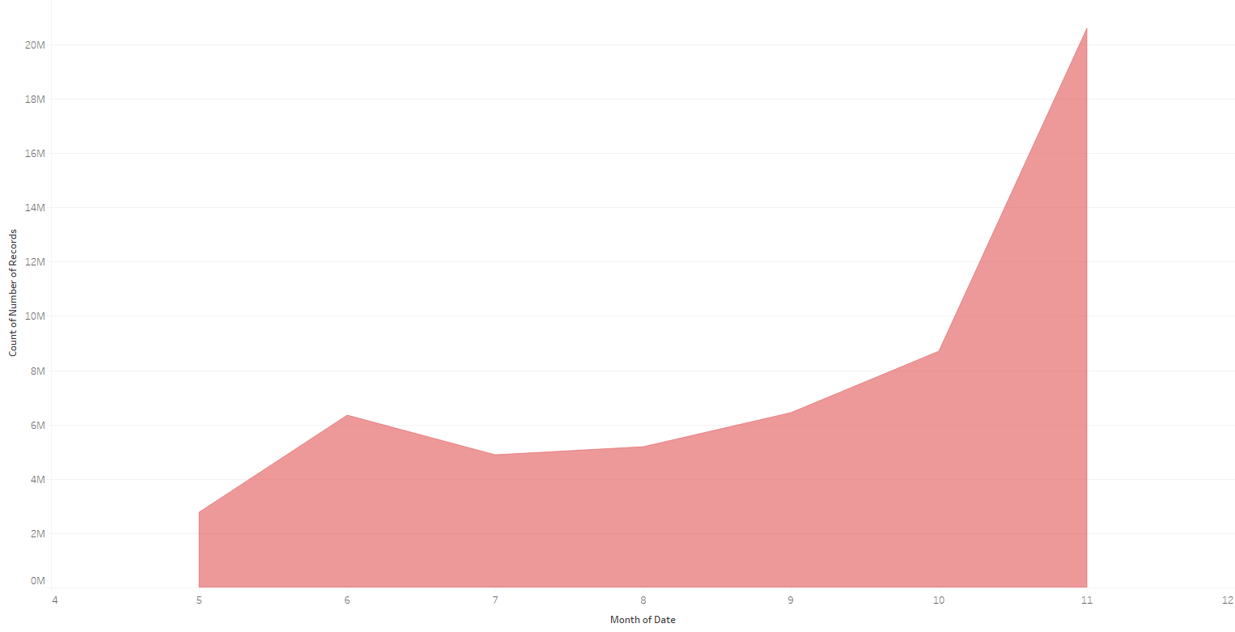
Data Source
Monthly Total Actions Trend
Double 11
6.18
Mid-year Shopping Festival

Slide 16
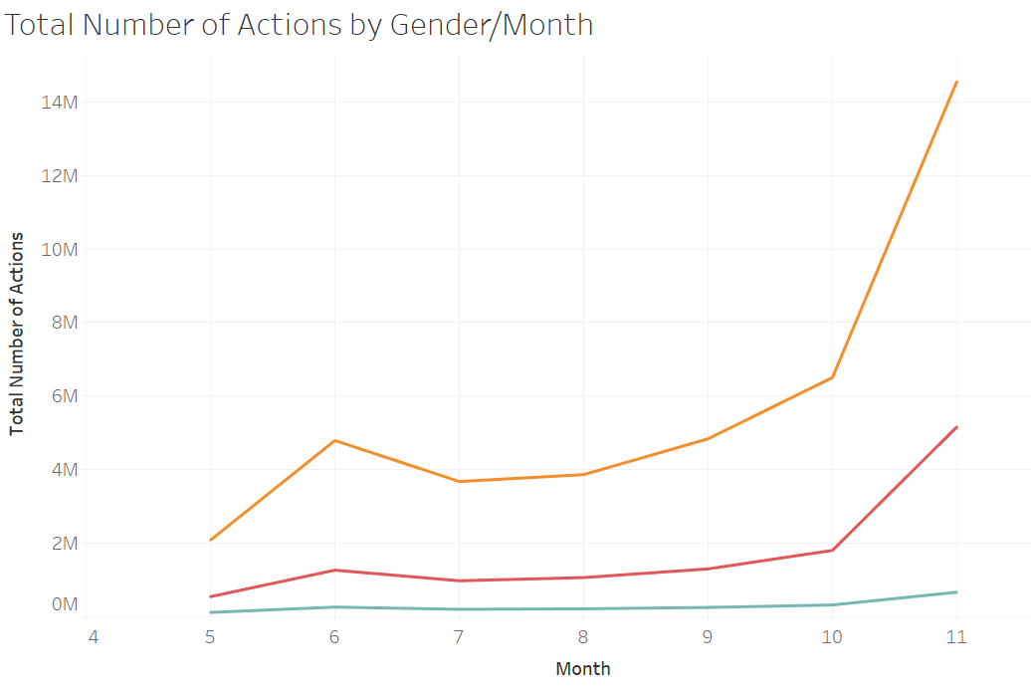
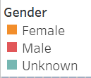
Data Source
Monthly Total Actions Trend by Gnder
Double 11
Total Actions by different gender seems to follow the same trend
6.18
Mid-year Shopping Festival

Slide 17
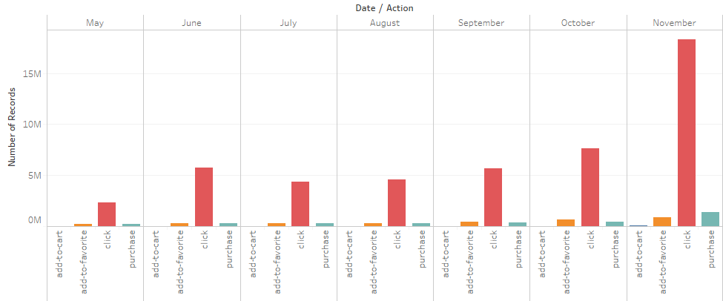
Data Source
Different Actions in Each Month
Click is the most fequent action
Purchase and Add-to-Favorite are almost equivalent...

Slide 18
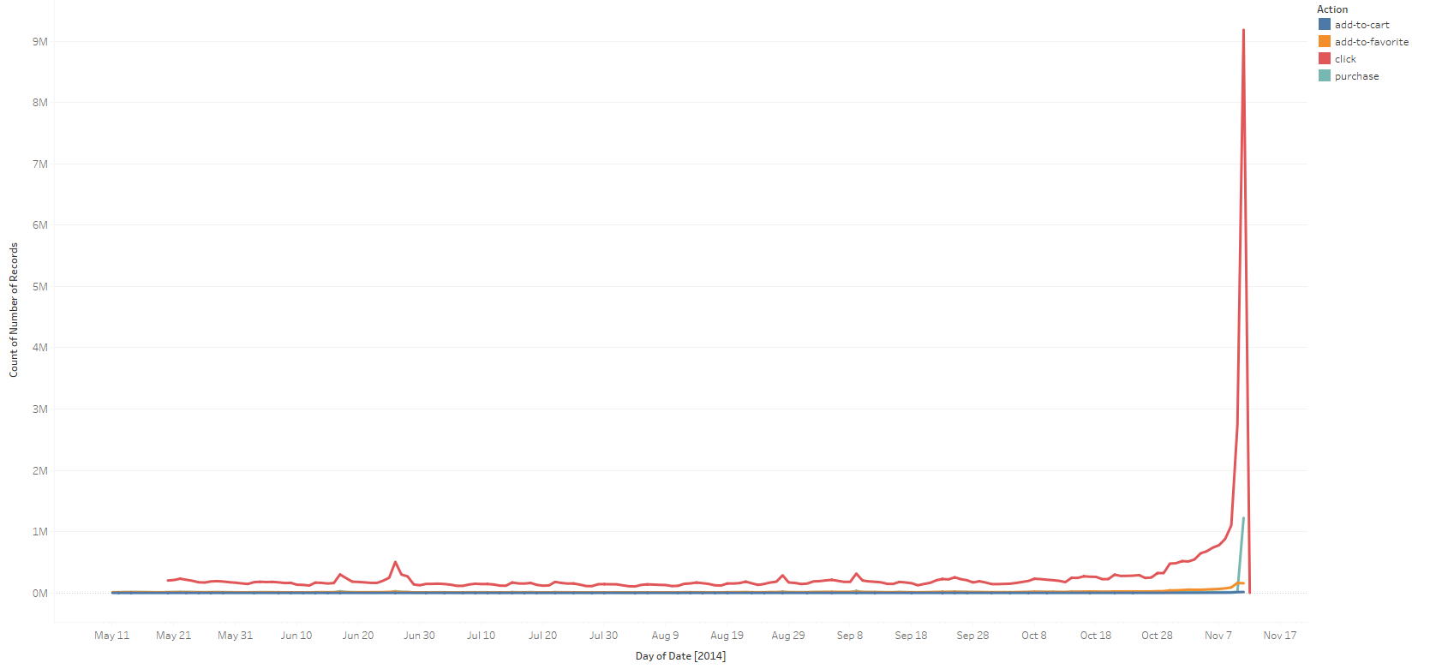
Data Source
Daily Trend
Drastically increase on Double 11!

Slide 19
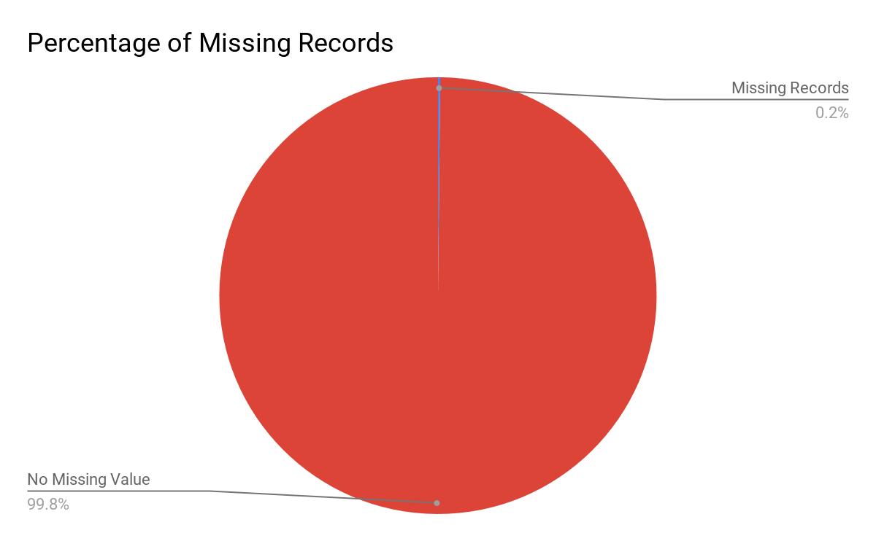
Data Source
Missing Data
We only have 0.2% of missingness in brand_id, which is not a big concern !

Slide 20
4
Feature Engineering
Notes:
5 sets of features: action, day,

Slide 21
Action-based Features
Action counts are the numbers of clicks, purchases, add-to-favorites, and add-to-carts over the whole data period
user level
merchant level
user-merchant level
Purchase ratio is the proportion of purchase over all action types
user level
merchant level
user-merchant level

Slide 22
Day-based Features
Action day counts are the numbers of days with a particular action type over the whole data period
user level
merchant level
user-merchant level
Purchase day ratio is the proportion of the number of days with purchase(s) over the number of total active days
mainly used to differentiate regular buyers from occasional buyers
E.g. a user with 10 purchase actions in one single day is different from another user with the same number of purchase actions that spread over 10 different days. The latter user is considered a more regular buyer than the former.

Slide 23
Product Diversity Features
Product diversity are the numbers of unique items, brands and categories that the user clicked, purchased, added to cart, or added to favorites over the whole data period
user level
merchant level
user-merchant level
The intuition behind product diversity features is that if a user is interested in more items of a merchant, then the user is more likely to buy again from the merchant

Slide 24
Recent Activity Features
Counts and ratios of clicks, purchases, add-to-favorites, and add-to-carts on the Double 11 day, in the last one week before Double 11, and in the last one month before Double 11
user-merchant level
E.g. double 11 purchase ratio = # of purchase on 11.11 / total # of purchase
If a user has a high Double 11 buy ratio, then the user is more likely to be a one-time deal hunter

Slide 25
Merchant’s Market Share Features
Intermidiate features: used to compute similarity scores
merchant-brand level
merchant-category level
Merchant’s market share measures how important a a merchant is to a brand/category
merchant’s market share on the brand/category =
# of actions of the brand/category from the merchant
# of actions of the brand/category from all the merchants

Slide 26
User-Merchant Similarity Features
User-merchant similarity measures how similar a user and a merchant are, based on brands or categories
user-merchant level
Similarity scores are calculated based on the merchant’s market share features and the preferences of users on brands/categories
user’s preference on the brand/category = # of actions on the brand/category
user-merchant similarity score = merchant’s market share × user’s preference
E.g. a merchant has 5 brands with respective market shares (0.1, 0.2, 0.05, 0.3, 0.01), and the number of times of a user buying the 5 brands are (0, 1, 2, 0, 2), then the brand similarity score is the sum of inner product of merchant’s market share and user’s preference: 0.1 × 0 + 0.2 × 1 + 0.05 × 2 + 0.3 × 0 + 0.01 × 2 = 0.32

Slide 27
Research Questions
Feature Summary
Action-based features
Product diversity
# of each action
# of total actions
% of purchase
ueser, merchant, user-merchant
# of unique items/categories/brands
ueser, merchant, user-merchant
81 features
User-merchant similarity
similarity score on brands/categories
user-merchant
Day-based features
# of days of each action
# of total active days
% of days with purchase
ueser, merchant, user-merchant
Recent Activity
Double 11/Latest one-week/Latest one-month features
# of each action
% of each action
user-merchant

Slide 28
5
Next Steps

Slide 29
Goal and Hypothesis
Next Steps
Feature Ranking
Prediction
Find out features that contribute the most to repeat purchases
Predict on testing data to get the out of sample error
Model Training
Model Iteration
Random Forest
GBM
XGBoost
Grid Search
Cross Validation

Slide 30
Thank You!
Q&A

